Slide 1


Kimberly-Clark BRAZIL fem care FINAL PRESENTATION marketing mix modeling – 2018
DECEMBER 12, 2018

Slide 2



Meeting PPO
Purpose
Process
Outcome
Evaluate and optimize Brasil Fem Care A&CP ROI
MRA/Nielsen to present MMM results and recommendations
All to discuss implications for 2019 and beyond
Alignment on opportunities and recommendations to best use media investment to achieve 2019 objectives

Slide 3
MMM is a business process to help Brazil FEM CARE Make Decisions rather than a one-off project
Results and Recos
Simulator and Scenario Testing
Make Decisions and Execute
MMM Evaluation
Ongoing Support
Obviously the business decisions are yours as brand owners and market experts
Analytics can help you make decisions, providing objective facts and insights
The real value is in combining the results with your market knowledge, and putting the theory into practice.
MRA Analytics, Nielsen, and Ogilvy/VML are here to help!
We are here

Slide 4
Why is Marketing Mix Analysis Important?
MEASURE
Measure the effectiveness and efficiency of last year’s marketing investments
Incremental volume generated
Financial ROI by activity
What worked well, what didn’t, and why?
IMPROVE
Improve next year’s marketing plan using knowledge gained
Adjust overall spending levels and allocation
Refine tactical execution
Uncover new marketing opportunities

Slide 5


Marketing mix uses patterns between changes in sales and activity to decompose volume
Align sales with activity
Hypothetical example
SU Sales
Price
TV
Attribute corresponding volume peaks and dips to activities
Decomposition
Notes:
Models rely on pattern recognition in which fluctuations in marketing elements — advertising, promotion, distribution, pricing, etc., — are isolated and compared to fluctuations in sales. When the patterns match, the incremental effects are attributed to the marketing elements that drove results.
Since sales vary week to week, if there is no variation in support over time in an independent variable for 12 or more weeks, it is unlikely to be a significant driver in the model.
Similarly, scale plays a role. If there are 100 shoppers in a store and only 2 are exposed to an activity, the change in total store sales due to the buying behavior of 2 shoppers is likely to be seen by the model as random variation.
Lastly, the ability to link participating consumers with the physical stores in which they shop greatly impacts the model’s ability to quantify the impact of a marketing vehicle

Slide 6
Integration of model results with financial data permits rich assessment of marketing impact
Incremental Volume
100,000 SU
Profit (GP)
$150,000
$1.50 GP per SU
Marketing
Activity
TV Advertising
Effectiveness
(Inc SU/GRP)
200
Efficiency
(Inc SU/$ Spent)
0.50
ROI = Payback
($ Inc Profit/$ Spent)
$0.75
Support
500 GRPs
Working Spending
$200,000
Notes:
Once the model quantifies the incremental volume generated by a channel, there are 3 important metrics that can be calculated:
The first is Effectiveness. If you divide the incremental sales (those that came as a result of marketing efforts) by the support (the execution of each marketing efforts, such as Target Rating Points for media) for each tactic, you get near-term Effectiveness
The second metric is near-term efficiency, which you can find by dividing incremental sales by expenditures (working spend) for each tactic
Lastly multiplying the incremental volume by VCM and dividing by its working spend yields ROI @ VCM.
Working spending is used in all channel level ROI calculations unless otherwise noted. This is due to the fact that many non-working costs are enterprise costs and MMM analysis period does not match delivery period and the potential to cloud executional recommendations if allocations are done incorrectly.
The lone exception to this is in the A&CP dashboard in which Total A&CP ROI is adjusted by fully working spending.

Slide 7

Allowing us to apply what we learn to best achieve our 2019 objectives
Priorities for the brand in 2019
MMM will provide insights
Increase brand strength
✪
Volume growth in the premium portfolio
✪
Volume growth and market share gain in liners
✪
Achieve leadership in Northeast
✪

Slide 8

This is the 2nd MMM for Intimus Brasil!

Slide 9



Learning & Implementation from Prior Study
1
Continue featuring multiple heros as opposed to one product
>> while keeping similar look & feel to drive halo
2
Increase PTV channel mix to 49% for LMO
>> due to strong synergistic relationship between Sony PTV and digital
3
Explore high ROI channels such as Digital and PTV for Tampons
>> based upon strong Maria’s tie-in
4
Optimize PTV within recommended range
>>PTV = 20 – 35 HH GRPs

Slide 10
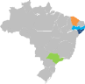

With this MMM update, we’ve increased our volume and media coverage
2016
Jul’14-Jun’16
MMM
2018
Jan’16 - Jul’18
MMM
Recife
Fortaleza
Salvador
São Paulo Metro (Area IV)
National
Recife
Fortaleza
Salvador
São Paulo Metro (Area IV)
São Paulo State (Area V)
Rio de Janeiro (Area III)
Belo Horizonte
Curitiba
Florianopolis
Porto Alegre
HSV projected to Total Shipments
ANALYSIS UNIVERSE
MT + TT projected to Total Shipments
ANALYSIS UNIVERSE
55%
VOLUME COVERAGE
100%
VOLUME COVERAGE
45%
MEDIA COVERED
88%
MEDIA COVERED
Rio 17.2%

Slide 11




Project Scope
MODEL BREAKDOWNS
CATEGORIES:
Feminine Care Pads, Liners, Tampons
 | Intimus Mainline Pads
 | Intimus Premium Day Pads (Evolution + Sport)
 | Intimus Overnight Pads
 | Intimus Liners
 | Intimus Tampons
COUNTRY: Brazil
CHANNEL: Total Brazil AS+Farma+C&C (MT)
Total Brazil INA+INFC (TT)
Shipment Coverage ~70%
TIME PERIOD:
January 2016 – July 2018
Comparison: August ‘16 – July ‘17 vs. August ‘17 – July ‘18
ROIs: CYs + YTD (Ending July ‘18)
OPEN TV DEEP-DIVES
Salvador
Recife
Fortaleza
Belo Horizonte
Rio de Janeiro
São Paulo Metro
São Paulo Estado
Curitiba
Florianopolis
Porto Alegre
REPORTING METRIC
ROI @ GROSS PROFIT
projected to total country shipments
Marketing Mix Modeling
Brazil K-C Fem Care 2018

Slide 12




The 5 main Cpis were analyzed with additional digital insight by variant
2016 Nordeste
(Carnaval & São João )
2016-17 Marias
(Manifesto)
2017 Let’s Move On
(Manifesto, OVN, Tampons)
2018 Sport
(Premium)
2018 She Can “Totex” (Manifesto, OVN)
Brazil K-C Fem Care 2018 Marketing Mix Modeling

Slide 13
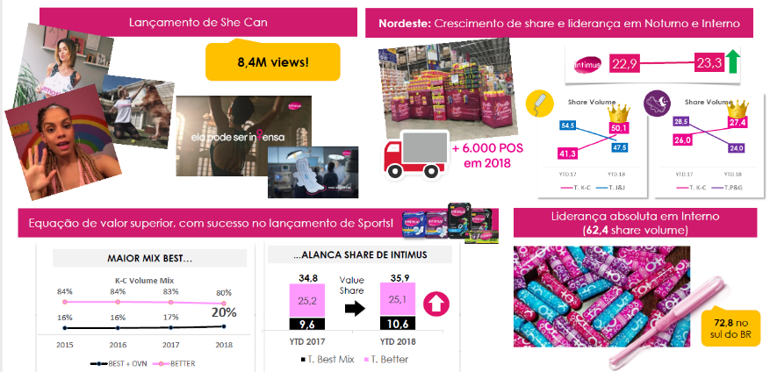
Many executional successes in 2018
Brazil K-C Fem Care 2018 Marketing Mix Modeling

Slide 14


distribution gains were not enough to offset YTD losses due to price, Media, & competition
Total INTIMUS Volume Due-To (MM)
Nielsen MT & TT including C&C (~72% of shipments)
%
Change
2.4%
+2.5%
+0.3%
+0.1%
+0.0%
-0.2%
-0.2%
-1.3%
-1.4%
-2.3%
Distribution growth (total porfolio) in C&C +4%, along with new items for Overnight, and launch of Sport
Regular price changes primarily from Sempre Livre and Always
Premium Pads TPR activity increased with change to Sport.
Mainline and Premium lost due to relaunch of Always Super Proteção
Pay TV execution down 73%, and Open TV investment fell, too.
Losses seen across the portfolio, but heaviest within Liners and Tampons
Brazil K-C Fem Care 2018 Marketing Mix Modeling

Slide 15
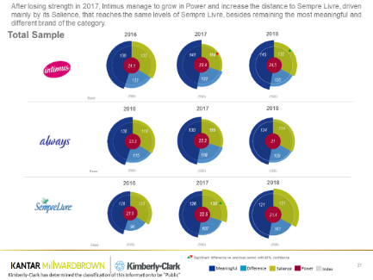
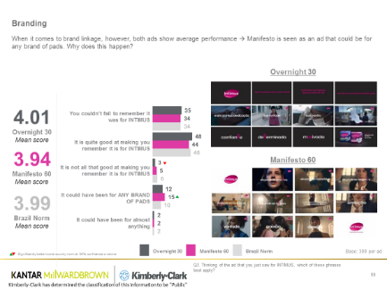
Intimus Equity is strong, But opportunity to improve brand linkage for cpis
Source: Kantar Milward Brown KC Equity Reporting Feminine Care 2018 – Brazil

Slide 16
tv costs have steadily increased, but tv response has not kept pace
Shift from sponsorships to 0:30s to communicate new message drives the FY17 increase while station (Fox & ESPN) and city mix drive YTD18 costs
Stronger brand linkage will drive higher lifts
 | Cost Trend | Lift Trend
OTV |  | ➲
PTV |  | ➲
Cost per HH GRP*
Lift** per 100 GRPs
3X
1X
4X
< 1X
*Regional OTV population estimates provided Ogilvy used to estimate nationalized GRPs
**Total Intimus Incremental SU per 100 HH GRPs / Avg Wkly Intimus SU
Brazil K-C Fem Care 2018 Marketing Mix Modeling

Slide 17


The unequal relationship between cost and lift has led to a steadily declining roi
FY 2016
FY 2017
H1 2018
0.64
ROI@GP
0.33
ROI@GP
0.20
ROI@GP
Media* Investment: R$ 4.0 MM
ST GP Contribution: R$ 2.5 MM
Media* Investment: R$12.6 MM
ST GP Contribution: R$ 4.1 MM
Media* Investment: R$4.3 MM
ST GP Contribution: R$ 0.7 MM
*Note, spending for activities for which there is no execution is excluded.
Bubble size = analyzed media investment. Full outer circle shaded means an ROI of 2, Circle has been shaded proportionately.
Brazil K-C Fem Care 2018 Marketing Mix Modeling

Slide 18
Roi DECLINE primarily driven by PTV Costs increasing more than PTV lift
Total INTIMUS ROI Decomposition
(Understanding Drivers of ROI Change FY’16 vs. FY ‘17 vs. H1 ‘18
%
Change
%
Change
-49%
-40%
Thanks to the margin increase ROI gain 0.02 higher
If our volume had remained constant, ROI would be 0.01 higher
3.5X higher CPP did not generate higher response causing a 0.19 decline in ROI
Increase in the effectiveness didn’t offset the 2.7X CPP causing a 0.09 decline in ROI
Operating within the optimal range would generate more volume /higher ROI
4X higher CPP did not generate 4X higher response causing a 0.09 decline in ROI
If our volume had remained constant, ROI would be 0.02 higher
If our margin have not decrease, ROI would have been 0.02$ higher
Operating within the optimal range would generate more volume /higher ROI
Brazil K-C Fem Care 2018 Marketing Mix Modeling

Slide 19






Intimus roi in line with argentina but lower than expected given Intimus brand size
ST ROI @ GP – Global markets
Source: KCI MMM Models

Slide 20





We will use MMM findings to improve our media investment to efficiently grow Intimus volume and profit
Step 1
Understanding volume drivers
Step 2
Optimizing Commercial programs
and Variants
Step3
Understanding media channel performance
Optimizing investment levels
within channel
Step 4

Slide 21






Growing distribution is key to sustaining base sales
Own Regular Price is a strong volume driver
Key takeaways from volume drivers
TV is an important volume driver, since it contributed to 85% of Total Media in YTD 17
Intimus performance is affected by Competitive activity

Slide 22




Media takeaways
1. Open TV is still worthy of investment, but with a prioritization within Salvador, Recife and Fortaleza and increased use of 0:15s for Manifesto spots
2. Continue Masterbrand CPIs with rotating variants as they drive greatest lifts to portfolio. Costs must be addressed on Pay TV!
3. YouTube and Facebook deserve more budget. Both are still below optimal levels and can grow on effectiveness. Optimize by cutting Snapchat
4. Sport media delivered low lift and ROI. Review media mix strategy including TV station selection and opportunity to include Manifesto
5. Looking to 2019… Link Liners to Manifesto to drive halo onto Pads vs. specific CPI alone
Brazil K-C Fem Care 2018 Marketing Mix Modeling

Slide 23




Using only efficiency (ROI) to evaluate campaign performance does not provide the full picture
R$ 10.7MM
R$ 0.68 MM
R$ 3.4MM
R$ 2.8 MM
R$ 0.9 MM
Spending for modeled vehicles only
Study period: January 16 to July 18
Brazil K-C Fem Care 2018 Marketing Mix Modeling

Slide 24




Total contribution (effectiveness) and halo should also be considered
Both LMO and Maria’s featured multiple product variant hero’s in addition to Masterbrand Manifesto
 | Mainline | Overnight | Premium | Liners | Tampons
Intimus Commercial Program
Carnaval-SJ R$0.7
Incremental
Contribution from Variant
Marias R$3.4 2016-17
Hero
Manifesto
LMO R$10.7 2017-18
Halo
Bubble size a function of response and investment
Sport R$2.8 2018
Brazil K-C Fem Care 2018 Marketing Mix Modeling
She Can R$0.9 2018

Slide 25
CPIs with both a Masterbrand and product hEro generate the highest variant lifts
 | Mainline | Overnight | Premium | Liners | Tampons
Linking Sport to a Manifesto should improve its halo onto other variants
Intimus Commercial Program
Carnaval-SJ R$0.7
Normalized TV Lift per 100 HH GRPs
Marias R$3.4 2016-17
Hero
Manifesto
LMO R$10.7 2017-18
Halo
Arrow size a function of response
Sport R$2.8 2018
Brazil K-C Fem Care 2018 Marketing Mix Modeling
She Can R$0.9 2018

Slide 26
CPIs with both a Masterbrand and product hEro generate the highest variant lifts
Linking Sport to a Manifesto should improve its halo onto other variants
 | Mainline | Overnight | Premium | Liners | Tampons
 | 3.0% | 3.5% | 2.6% | 2.0% | 2.7%
 | 6.3% | 4.7% | 3.2% | 4.5% | 3.1%
 | 5,7% | 4.8% | 3.9% | 4.2% | 4.2%
 | 3.6% | 2.8% | 5.0% | 3.1% | 2.3%
 | 5.4% | 5.8% | 4.5% | 4.3% | 2.8%
Intimus Commercial Program
Carnaval-SJ R$0.7
Normalized OTV & PTV Lift per 100 HH GRPs
Marias R$3.4 2016-17
Hero
Manifesto
LMO R$10.7 2017-18
Halo
Arrow size a function of response
Sport R$2.8 2018
Brazil K-C Fem Care 2018 Marketing Mix Modeling
She Can R$0.9 2018

Slide 27

Product hero social delivers strong lift to variant but lower halo, particularly for sport
Total Direct +Halo
Normalized Response (Average Weekly Lift per 100 GRPs)
Direct
Avg MB
Short-Term Only FB/IG ROI
 | Masterbrand | Liners | Sport | Overnight | Tampons
Spending (BRL) | 2,388,144 | 94,999 | 468,228 | 152,094 | 284,066
‘000 Imp | 620,808 | 25,389 | 128,725 | 62,949 | 109,367
Cost per ‘000 Imp | 3.85 | 3.74 | 3.64 | 2.42 | 2.60
Brazil K-C Fem Care 2018 Marketing Mix Modeling

Slide 28

Manifesto youtube campaigns delivered strong lifts to the portfolio
Direct
Total Direct +Halo
Normalized Response (Average Weekly Lift per 100 GRPs)
Avg MB
Short-Term YouTube ROI
 | Masterbrand | Liners | Sport
Spending (BRL) | 1,064,566 | 200,327 | 338,195
‘000 Imp | 77,908 | 14,005 | 38,386
Cost per ‘000 Imp | 13.66 | 14.30 | 8.81
Brazil K-C Fem Care 2018 Marketing Mix Modeling

Slide 29
TV is still worthy of investment as it’s needed to drive volume
Digital has the most opportunity for improvement given the volume response dispate the low incremental volume
Re-evaluate role of OOH
FY2017
OPPORTUNITY TO RAISE STRATEGIC INVESTMENT
HIGH POTENTIAL
GP ROI
Size of bubble: Spending
EVALUATE
MANTAIN AND OPTIMIZE INVESTMENT
% Volume Contribution
OOH
Digital
Radio
Pay TV
Open TV
Brazil K-C Fem Care 2018 Marketing Mix Modeling

Slide 30
Prioritize Northeast for increased tv support
Deprioritize Porto Alege, Curitiba and Florianópolis due to low response and ROI.
OPPORTUNITY TO RAISE STRATEGIC INVESTMENT
HIGH POTENTIAL
GP ROI
Size of bubble: Cost per GRP
EVALUATE
% Normalized Response
MANTAIN AND OPTIMIZE INVESTMENT
Brazil K-C Fem Care 2018 Marketing Mix Modeling

Slide 31
OPEN TV optimal ranges
Watch out for extended period of low weights, there is room to optimize between the burst activity and the following weeks. Keep higher weights when introducing new emotional message campaigns.
Regional Optimal Weekly GRPs Ranges
NUMBER OF WEEKS*
ON AIR | BELOW | WITHIN | ABOVE
252
275
435
80 | 67 | 6 | 7
53
267
427
65 | 62 | 0 | 3
170
214
271
64 | 46 | 6 | 12
85
256
410
4 | 4 | 0 | 0
Average Execution
Optimal Range
*Modelled campaigns
Brazil K-C Fem Care 2018 Marketing Mix Modeling

Slide 32
2018 PTV costs are almost 4x higher than nielsen norms
What is happening with Intimus PTV costs?
Nielsen Latam NORMs
R$917
2016: Due to good negotiation with SONY channel, costs were 4x below Nielsen NORMs
2018: Increase on all channels costs, while allocating 77% of the execution on the most expensive channels
2017: Increase of channel mix kept costs on average compared to Nielsen NORMs
Pay TV Cost
(BRL/GRP)
R$3,162
R$12,001
R$3,617
R$5,311
R$8,130
R$978
R$18,332
R$13,472
R$7,167
R$1,618
R$12,567
Source: Nielsen Marketing Mix | All CPG categories | LatAm all data up to Q1`18
Notes:
2016: Only SONY with great cost and mainly 5’ and 15’
2017: Buying more expensive channels: Multishow (Globosat), TNT, Universal, Discovery H&H, Warner. 2018: 67% Share of GRPs on more expensive FOX channels and keep with other expensive channels such as Multishow and TNT. Mainly 30’ with high cost

Slide 33

PAY TV OPTIMAL RANGES
Lower weights in 2018 for Sport and Totex likely contributed to lower responses
Average weekly GRPs: 19
Weeks Below: 49
Weeks Within: 17
Weeks Above: 53
Max Weeks Off-air: 2
Max ROI
Max Marginal
Max ROI
Max Marginal
ROI
Weekly GRPs*
Optimal Range
Max Marginal ROI | 14
Max ROI | 23
Max Marginal ROI
Max ROI
*Nationalized GRPs
Brazil K-C Fem Care 2018 Marketing Mix Modeling

Slide 34




shift SPENDING FROM SNAPCHAT AND INCREASING YT, FB AND IG WEIGHTS AS AN OPPORTUNITY TO GENERATE BETTER LIFTS
Brazil K-C Fem Care 2018 Marketing Mix Modeling

Slide 35
Youtube investment and roi growing, still with potential for more growth
Costs are improving!
More focus on Sport and Liners in 2018 reduced halo power to Mainline Pads, causing a decline in response.
However, heavier weights over time have been helping YouTube perfomance overall.
ROI
Continue increasing YouTube investment.
Even with costs staying flat, we can still see a higher ROI!
COSTS
SPENDING
EXECUTION LEVELS
BRL Per M Impressions
BRL (M)
Weekly Impressions (M)
Brazil K-C Fem Care 2018 Marketing Mix Modeling

Slide 36

Online - optimal execution ranges
Average execution levels for Facebook and YouTube are below recommended becoming an important opportunity that will impact directly both ROI and Effectiveness.
Online Optimal Weekly (‘000) BRL Ranges
32
34
59
20
49
86
Average Execution
Optimal Range
Brazil K-C Fem Care 2018 Marketing Mix Modeling

Slide 37
OPTIMIZATION

Slide 38
biggest opportunity to improve roi is fixing tv cost and city mix
Increasing Digital support to within recommended ranges will also improve ROI
From | To | Change in Spending (‘000) BRL | Change in Incremental GP (‘000) BRL | Change in ROI
High PTV cost | Improving PTV costs to Nielsen norms | - R$ 857 | +R$ 135 | +R$ 0.12
OTV in South | Focusing OTV in NE | +R$ 0 | -R$ 509 | +R$ 0.27
Sub-optimal YouTube investment | Increasing digital investment for YouTube | +R$ 159 | +R$ 72 | +R$ 0.08
Sub-optimal Facebook investment | Increasing digital investment for FB | +R$ 256 | +R$ 146 | +R$ 0.05
High use of % 0:30s | Launch campaigns with 50% of spend in 0:30s and 50% in 0:15s to maximize weekly weight and/or reinvest savings in Digital. Assumes 0:15s are 80% as effectives as 0:30s but 50% of cost | - R$ 430 | - R$693 | + R$ 0.05
Variant specific CPI | To drive lift to a variant and better halo onto Pads, include Manifesto with Product Hero | +R$ 0 | +R$ 64 | +0.06
Total |  | - R$ 872 | - R$ 785 | + R$ 0.18
Assumptions: 1) PTV cost $3,600 2) Same total OTV spend with South investment reallocated to NE 3&4) increasing digital investment 4) assumes 0:15s are 50% cost and 80% effectiveness of 0:30 5) assumes same spend and Sport halo improved to Manifest halo from She Can
Brazil K-C Fem Care 2018 Marketing Mix Modeling

Slide 39

intimus optimization opportunities
Cut from OOH to fund Digital to 46% of budget, prioritizing Facebook and YouTube. Also, improving the cost of Pay TV and focusing in NE for OTV will be key ROI driver.
ROI @ GP
0.20
+94%
0.38
Optimization done based on Costs analysis
Flighting optimizations pending.

Slide 40
Media takeaways
1. Open TV is still worthy of investment, but with a prioritization within Salvador, Recife and Fortaleza and increased use of 0:15s for Manifesto spots
2. Continue Masterbrand CPIs with rotating variants as they drive greatest lifts to portfolio. Costs must be addressed on Pay TV!
3. YouTube and Facebook deserve more budget. Both are still below optimal levels and can grow on effectiveness. Optimize by cutting Snapchat
4. Sport media delivered low lift and ROI. Review media mix strategy including TV station selection and opportunity to include Manifesto
5. Looking to 2019… Link Liners to Manifesto to drive halo onto Pads vs. specific CPI alone
Brazil K-C Fem Care 2018 Marketing Mix Modeling

Slide 41
Detailed media results

Slide 42
Offline Media execution summary
Open TV
Pay TV
Radio
OOH
Marketing Mix Modeling
Final Presentation Brazil Fem Care 2018

Slide 43

Online Media execution summary
Facebook + IG
Online Video
Marketing Mix Modeling
Final Presentation Brazil Fem Care 2018

Slide 44
Although TV ROI declined, Digital was relatively flat and Radio improved
Total ROI Summary
-49%
-40%
-63%
-52%
+33%
+4%
Marketing Mix Modeling
Final Presentation Brazil Fem Care 2018

Slide 45
OPEN TV

Slide 46
INTIMUS open TV Performance
Total Intimus (Pads, Overnight, Premium, Tampons and Liners)
oTV Driven gp Incr. Revenue (‘000 BRL) | oTV Volume Response Average Weekly Lift per 100 GRPs* | oTV Short term ROI GP PER R$1 SPENT
GRPs*
Spending (BRL)
300 | 577 | -
1.1MM | 5.6MM | -
Contribution in Total Media %
CPP (BRL)*
12% | 33% | -
3,665 | 9,698 | -
*GRPs and Spending for modeled campaigns only.
Marketing Mix Modeling
Final Presentation Brazil Fem Care2018

Slide 47


Open tv campaigns
Direct
Total Direct +Halo
Normalized Response (Average Weekly Lift per 100 GRPs)
Short-Term Only Open TV ROI
 | Masterbrand |  | Tampons
Spending (BRL) | 593,582 | 4,952,583 | 1,150,596
GRPs | 278 | 568 | 31
Cost per GRP | 2,138 | 8,713 | 36,901
*Let`s Move On grouped across variants

Slide 48



Continue Masterbrand TVCs as they halo strongly onto the portfolio
Direct
Total Direct +Halo
Normalized Response (Average Weekly Lift per 100 GRPs)
Short-Term Only Pay TV ROI
 | Masterbrand |  | Premium | Masterbrand
Spending (BRL) | 737,727 | 3,990,720 | 1,084,758 | 639,059
GRPs | 786 | 1,280 | 105 | 38
Cost per GRP | 939 | 3,117 | 10,301 | 16,673

Slide 49
Salvador, fortaleza and recife with great opportunity to increase execution. Deprioritize porto alegrE, curitiba and florianÓpolis.
OPPORTUNITY TO RAISE STRATEGIC INVESTMENT
HIGH POTENTIAL
GP ROI
Size of bubble: Cost per GRP
EVALUATE
% Normalized Response
MANTAIN AND OPTIMIZE INVESTMENT

Slide 50
Understanding the Response curve
ILLUSTRATIVE EXAMPLE
C | Max ROI | The point at which the ROI is maximized.
B | Max Marginal | The execution required to get maximum marginal volume response per execution
A | Threshold | Minimum execution required to have a significant impact on demand.
ROI is now decreasing
C
Optimal Range
The marginal increase per execution decreases, but cumulative is still increasing
B
Every increase in execution point leads to higher marginal incremental volume.
A
Optimal range to be between point B and C

Slide 51
Open tv OPTIMAL RANGES
Watch out for extended period of low weights, there is room to optimize between the burst activity and the following weeks. Keep higher weights when introducing new emotional message campaigns.
Max Weeks Off-air: 2
Average weekly GRP: 9
Weeks Below: 76
Weeks Within: 11
Weeks Above: 11
Max ROI
Max Marginal
Max ROI
Max Marginal
ROI
Weekly Impressions
Optimal Range
Max Marginal ROI | 15
Max ROI | 24
Max Marginal ROI
Max ROI

Slide 52
PAY TV

Slide 53
INTIMUS PAY TV Performance
Total Intimus (Pads, Overnight, Premium, Tampons and Liners)
pTV Driven gp Incr. Revenue (‘000 BRL) | pTV volume Response Average Weekly Lift per 100 GRPs | pTV Short term ROI GP PER $1 SPENT
GRPs
Spending (BRL)
804 | 1,262 | 144
0.7MM | 3.9MM | 1.7MM
Contribution in Total Media%
CPP (BRL)
59% | 53% | 35%
917 | 3,162 | 12,001
*GRPs and Spending for modeled campaigns only.
Marketing Mix Modeling
Final Presentation Brazil Fem Care2018

Slide 54
2017 costs grew due to channel mix and mainly 30’ 2018 costs continued to grow across the board
2016
2017
2018
R$5,311
R$8,130
R$762
R$978
R$18,332
R$2,307
R$13,472
R$7,167
R$1,618
R$12,567
R$2,358
R$2,548
R$13,598
R$350
R$2,325
R$4,501
R$731
R$12,457
R$2,305
R$11,438
R$11,438
R$17,218
Others: 20”, 60”, 300”
Others: 20”, 60”, 300”
Others: 60”, 300”
Notes:
2016: Only SONY with great cost and mainly 5’ and 15’
2017: Buying more expensive channels: Multishow (Globosat), TNT, Universal, Discovery H&H, Warner. 2018: 67% Share of GRPs on more expensive FOX channels and keep with other expensive channels such as Multishow and TNT. Mainly 30’ with high cost

Slide 55
Pay tv costs have been constantly increasing each year and is now almost 4x higher than nielsen norms
What is happening with Intimus PTV costs?
Nielsen Latam NORMs
R$917
2016: Due to good negotiation with SONY channel, costs were 4x below Nielsen NORMs
2018: Increase on all channels costs, while allocating 77% of the execution on the most expensive channels
2017: Increase of channel mix kept costs on average compared to Nielsen NORMs
Pay TV Cost
(BRL/GRP)
R$3,162
R$12,001
R$3,617
R$5,311
R$8,130
R$978
R$18,332
R$13,472
R$7,167
Source: Nielsen Marketing Mix | All CPG categories | LatAm all data up to Q1`18
R$1,618
R$12,567
Notes:
2016: Only SONY with great cost and mainly 5’ and 15’
2017: Buying more expensive channels: Multishow (Globosat), TNT, Universal, Discovery H&H, Warner. 2018: 67% Share of GRPs on more expensive FOX channels and keep with other expensive channels such as Multishow and TNT. Mainly 30’ with high cost

Slide 56
Pay tv campaigns
Direct
Total Direct +Halo
Normalized Response (Average Weekly Lift per 100 GRPs)
Short-Term Only Pay TV ROI
 | Masterbrand |  | Premium | Masterbrand
Spending (BRL) | 737,727 | 3,990,720 | 1,084,758 | 639,059
GRPs | 786 | 1,280 | 105 | 38
Cost per GRP | 939 | 3,117 | 10,301 | 16,673

Slide 57
PAY TV OPTIMAL RANGES
Lower weights in 2018 for Sport and Totex likely contributed to lower responses
Average weekly GRPs: 19
Weeks Below: 49
Weeks Within: 17
Weeks Above: 53
Max Weeks Off-air: 2
Max ROI
Max Marginal
Max ROI
Max Marginal
ROI
Weekly GRPs*
Optimal Range
Max Marginal ROI | 14
Max ROI | 23
Max Marginal ROI
Max ROI
*Nationalized GRPs

Slide 58
radio

Slide 59
INTIMUS RADIO Performance
Total Intimus (Pads, Overnight, Premium, Tampons and Liners)
RADIO Driven gp Incr. Revenue (‘000 BRL) | RADIO volume Response Average Weekly Lift per 100 INSERTIONS* | RADIO Short term ROI GP PER $1 SPENT
Insertions*
Spending (BRL)
636 | 762 | 1,289
184M | 122M | 89M
CPP (BRL)
Contribution in Total Media %
290 | 160 | 69
1.1% | 1.3% | 14.4%
*Insertions and Spending for modeled campaigns only.
Marketing Mix Modeling
Final Presentation Brazil Fem Care2018

Slide 60
Radio consistently improved costs by switching channels AND REGIONS from northeast to south
2016
2017
2018
Northeast
South
R$148
R$131
R$365
R$100
R$64
R$389
R$311
R$83
2016 Cost per Insertion:
R$ 290
2016 Cost per Insertion:
R$ 160
2016 Cost per Insertion:
R$ 69
Notes:
2016: Focus on Northeast (Carnaval and S. Joao) with 30’ higher cost
2017: Different channels, switching to South (Tampons) and Rede Pampa with decreasing costs for 30’
2018: Focus on South with even better costs for 30’ on Rede Pampa

Slide 61
OOH

Slide 62
INTIMUS OOH Performance
OOH volume response in YTD18 was impacted due to lack of halo’ing onto Mainline
OOH volume Response Average Weekly Lift per 100 FACES*
Normalized Response (Average Weekly Lift per 100 Faces)
Direct
Total Direct +Halo
Short-Term Only OOH ROI
OOH Short term ROI GP PER $1 SPENT
 | Masterbrand | Premium | Tampons
Spending (BRL) | 884,431 | 130,571 | 106,599
Faces | 1,448 | 960 | 1,645
Cost per Face | 611 | 136 | 64
*Faces from Media plan file shared by Ogilvy. **From Execution base file shared by Ogilvy
Marketing Mix Modeling
Final Presentation Brazil Fem Care2018

Slide 63
ONLINE

Slide 64
SOCIAL MEDIA data

Slide 65
INTIMUS facebook+ig Performance
ROI falling due to the decline in the effectiveness, primarly driven by the lower halo from Sport and Overnight
Facebook+IG Driven gp Incr. Revenue (‘000 BRL) | Facebook+IG volume Response Average Weekly Lift per 100 GRPs | Facebook+IG Short term ROI GP PER $1 SPENT
‘000 Impressions*
Spending (BRL)
490,757 | 261,185 | 195,295
1.7MM | 0.9MM | 0.7MM
Contribution in Total Media %
CPM (BRL/’000 Impressions)
27% | 8% | 30%
3.58 | 3.76 | 3.33
*Impressions and Spending for modeled campaigns only.
Marketing Mix Modeling
Final Presentation Brazil Fem Care2018

Slide 66
Facebook/instagram campaigns by segment
Direct
Total Direct +Halo
Normalized Response (Average Weekly Lift per 100 GRPs)
Short-Term Only FB/IG ROI
 | Masterbrand | Liners | Sport | Overnight | Tampons
Spending (BRL) | 2,388,144 | 94,999 | 468,228 | 152,094 | 284,066
‘000 Imp | 620,808 | 25,389 | 128,725 | 62,949 | 109,367
Cost per ‘000 Imp | 3.85 | 3.74 | 3.64 | 2.42 | 2.60
Marketing Mix Modeling
Final Presentation Brazil Fem Care 2018

Slide 67
Facebook/instagram campaigns
Normalized Response (Average Weekly Lift per 100 GRPs)
Short-Term Only FB/IG ROI
 | Masterbrand |  |  |  | Overnight | Premium
Spending (BRL) | 44,379 | 84,321 | 2,275,002 | 469,265 | 46,035 | 468,229
‘000 Imp | 13,746 | 28,399 | 582,499 | 182,983 | 10,836 | 128,725
Cost per ‘000 Imp | 3.23 | 2.97 | 3.91 | 2.56 | 4.25 | 3.64
Marketing Mix Modeling
Final Presentation Brazil Fem Care 2018

Slide 68

INTIMUS snapchat Performance
Total Intimus (Pads, Overnight, Premium, Tampons and Liners)
snapchat Driven gp Incr. Revenue (‘000 BRL) | snapchat volume Response Average Weekly Lift per 100 GRPs | SNAPCHAT Short term ROI GP PER $1 SPENT
‘000 Impressions*
Spending (BRL)
- | 43,315 | -
- | 329M | -
Contribution in Total Media %
CPM (BRL/’000 Impressions)
- | 0.6% | -
- | 7.61 | -
*Impressions and Spending for modeled campaigns only.
Marketing Mix Modeling
Final Presentation Brazil Fem Care2018

Slide 69
Online video data

Slide 70
INTIMUS youtube Performance
Total Intimus (Pads, Overnights, Premium, Tampons and Liners)
Youtube Driven gp Incr. GP (‘000 BRL) | youtube volume Response Average Weekly Lift per 100 GRPs | youtube Short term ROI GP PER $1 SPENT
‘000 Impressions*
Spending (BRL)
8,677 | 37,884 | 83,739
182M | 674M | 746M
Contribution in Total Media %
CPM (BRL/’000 Impressions)
1% | 2% | 18%
20.96 | 17.80 | 8.92
*Impressions and Spending for modeled campaigns only.
Marketing Mix Modeling
Final Presentation Brazil Fem Care2018

Slide 71
Youtube investment and roi growing, still with potential for more growth
Costs are improving!
More focus on Sport and Liners in 2018 reduced halo power to Mainline Pads, causing a decline in response.
However, heavier weights over time have been helping YouTube perfomance overall.
ROI
Continue increasing YouTube investment.
Even with costs staying flat, we can still see a higher ROI!
COSTS
SPENDING
EXECUTION LEVELS
BRL Per M Impressions
BRL (M)
Weekly Impressions (M)

Slide 72
Youtube campaigns by segments
Direct
Total Direct +Halo
Normalized Response (Average Weekly Lift per 100 GRPs)
Short-Term YouTube ROI
 | Masterbrand | Liners | Sport
Spending (BRL) | 1,064,566 | 200,327 | 338,195
‘000 Imp | 77,908 | 14,005 | 38,386
Cost per ‘000 Imp | 13.66 | 14.30 | 8.81
Marketing Mix Modeling
Final Presentation Brazil Fem Care 2018

Slide 73
Youtube campaigns
Normalized Response (Average Weekly Lift per 100 GRPs)
Short-Term YouTube ROI
 | Masterbrand |  | Liners | Premium Pads | Masterbrand
Spending (BRL) | 449,994 | 391,146 | 200,327 | 338,195 | 223,424
‘000 Imp | 23,409 | 29,323 | 14,005 | 38,386 | 25,175
Cost per ‘000 Imp | 19.22 | 13.34 | 14.30 | 8.81 | 8.87
Marketing Mix Modeling
Final Presentation Brazil Fem Care 2018

Slide 74
Online - optimal execution ranges
Average execution levels for Facebook and YouTube are below recommended becoming an important opportunity that will impact directly both ROI and Effectiveness.
Online Optimal Weekly MM Impression Ranges
8.9
9.5
16.4
1.6
4.0
6.9
Average Execution
Optimal Range

Slide 75
Online - optimal execution ranges
Average execution levels for Facebook and YouTube are below recommended becoming an important opportunity that will impact directly both ROI and Effectiveness.
Online Optimal Weekly (‘000) BRL Ranges
32
34
59
20
49
86
Average Execution
Optimal Range

Slide 76
appendix

Slide 77
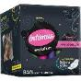
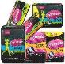
Support innovation with no more than 25% of total media spending
Shelf success, but media limitations. Do not over-invest in Sport media at the expense of Masterbrand activities.
Good news: Sport helped recover sales lost by Evolution removal.
However, Sport is still very small comprising only 2% of Pads, 2% of Liners and 3% of Tampons sales.
AT THE SHELF
21%*
Across Pads, Liners, Tampons
Modern Trade Sales through June 2018
Franchise Normalized Effectiveness
Pay TV
Bad news: Sport performed weakly on Tampons and Liners, and has not shown it can halo onto Mainline and Overnight.
Across Pay TV, Facebook/IG, and OOH, Sport performed near the bottom due to low halo.
MEDIA PERFORMANCE
Planning: Continue to support Sport, but no more than 25% of total media spending.
59% in YTD 2018 was too highly focused on Sport. Divert part of planned budget to masterbrand campaigns, ideally no more than 30% total dedicated to Sport.
2019 PLANNING RECOS
*2018 YTD compared to YTD 2017

Slide 78
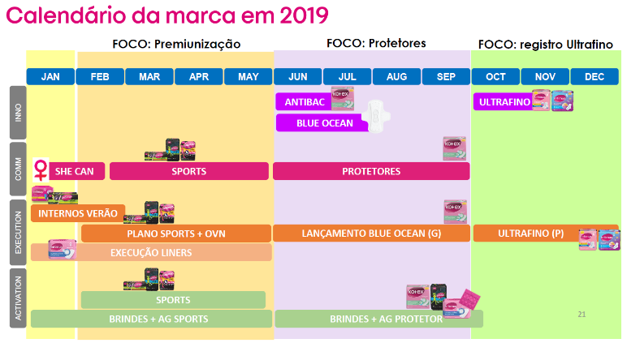

Slide 79
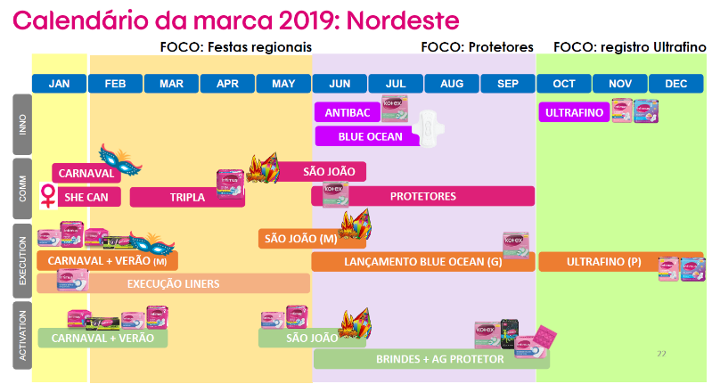

Slide 80
DETAILED TRADE RESULTS

Slide 81
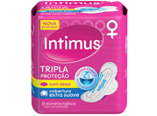
Mainline pads respond well to tpr ~30% incrementality between years
Modern Trade Volume sold by Discount Range
Volume in TPR
Mainline pads | Temporary Price Reductions (TPRs)
 | 2016 | 2017 | %CHG | YTD18
%Store/weeks with tpr | 15.2% | 18.1% | +2.9 pp | 19.9%
%volume (PADS) with tpr | 22.1% | 26.4% | +4.3 pp | 25.6%
Brazil K-C Fem Care 2018
Marketing Mix Modeling

Slide 82
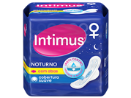
Tpr effectiveness has fallen for overnight as lower discounts have been offered
Modern Trade Volume sold by Discount Range
Volume in TPR
OVERNIGHT pads | Temporary Price Reductions (TPRs)
 | 2016 | 2017 | %CHG | YTD18
%Store/weeks with tpr | 9.8% | 11.3% | +1.5 pp | 12.1%
%volume (PADS) with tpr | 12.4% | 16.3% | +3.8 pp | 14.0%
Brazil K-C Fem Care 2018
Marketing Mix Modeling

Slide 83
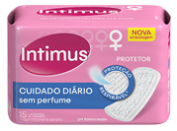
LINERS HAS INCREASED ITS RELIANCE ON TPRS SINCE 2016, BUT HAS ALSO INCREASED IN ITS INCREMENTALITY
Modern Trade Volume sold by Discount Range
Volume in TPR
LINERS | Temporary Price Reductions (TPRs)
 | 2016 | 2017 | %CHG | YTD18
%Store/weeks with tpr | 21.7% | 24.6% | +5.5 pp | 24.1%
%volume (linerS) with tpr | 26.1% | 31.5% | +2.9 pp | 29.7%
Brazil K-C Fem Care 2018
Marketing Mix Modeling

Slide 84
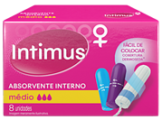
SEASONAL FORCES AT PLAY WITH MORE TPR DURING SUMMER MONTHS – INCREMENTALITY FLAT ACROSS MODEL SCOPE
Modern Trade Volume sold by Discount Range
Volume in TPR
TAMPONS | Temporary Price Reductions (TPRs)
 | 2016 | 2017 | %CHG | YTD18
%Store/weeks with tpr | 11.0% | 9.2% | -1.8 pp | 11.9%
%volume (TamponS) with tpr | 11.3% | 11.7% | +0.4 pp | 13.0%
Brazil K-C Fem Care 2018
Marketing Mix Modeling

Slide 85
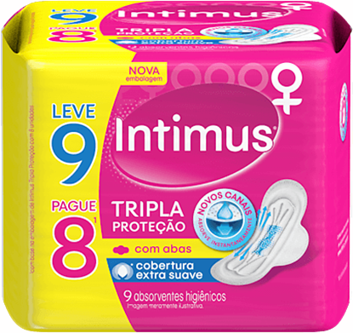
Special pack performance
“Leve 9 Pague 8” offering was 21% incremental in Traditional Trade
Volume Sold on Tripla LV9PG8 Special Pack
Brazil K-C Fem Care 2018
Marketing Mix Modeling

Slide 86
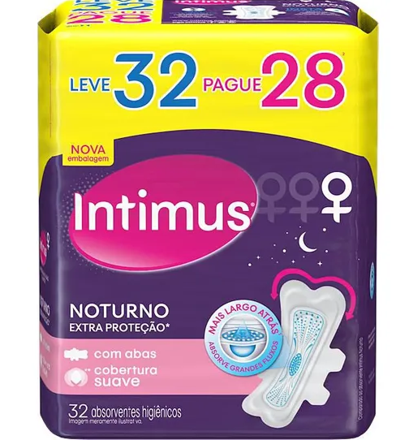
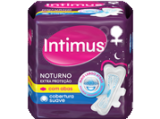
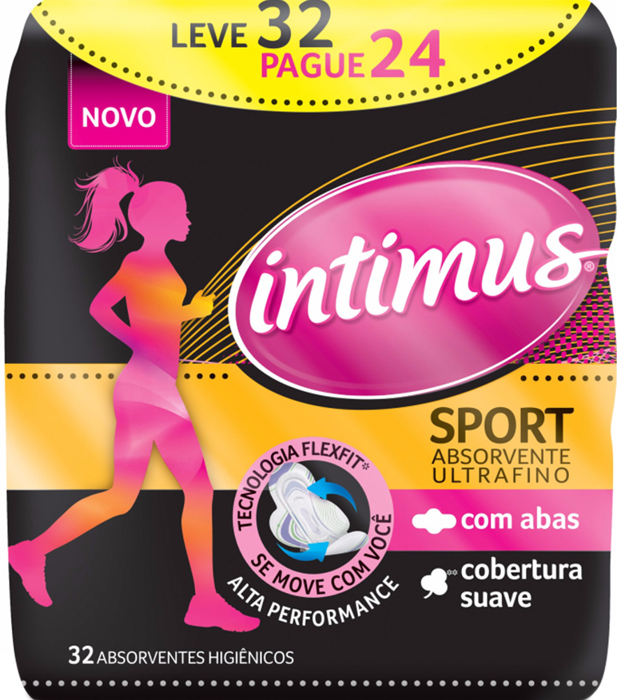
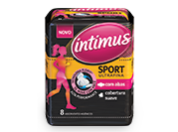
Intimus innovations leveraged incremental sales, especially on the traditional channel
MT Incrementality
TT Incrementality
Brazil K-C Fem Care 2018
Marketing Mix Modeling

Slide 87


Trade actions
From Data Review
Based on the feasibility of information received, the following activities will be considered:
Activity
Categories
Period
Granularity
Max quantity to be included
1
Promo Compre/Ganhe
Jan2016
Jun2016
Retailer by City
642 City-Retailer
R$ 1,750,102 Investment
Intimus all
Intimus all
Overnight
Liners
Mainline Pads
Sport
2
Jan2017
Ago2018
13,931 Store week
R$ 2,382,000 Investment
Brinde
Store level
3
Sport
Mar2018
May2018
65 Store week
R$ 936,000 Investment
MPDV
Store level
Data Review KC Fem Care 2018
Source: KC | 201601 to 201807

Slide 88




Trade activities performance
Gifts generate higher lifts, but come with much greater costs. For efficiency, focus more towards consumer promotions.
City/Retailer %Lift
Store/Week %Lift
Store/Week %Lift
“Buy and Win”
“Gifts”
Display + extra point
Total ROI | 0.24 | 0.03 | -
Brazil K-C Fem Care 2018
Marketing Mix Modeling

Slide 89
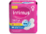
Continued increase in distribution and special packs within tt were biggest gains
The biggest losses came from launch of Always Super Proteção and decreased media investments.
MAINLINE PADS Volume Due-To (MM)
Nielsen MT & TT including C&C (~72% of shipments)
%
Change
4.3%
+2.7%
+0.4%
+0.3%
+0.0%
-0.3%
-1.6%
-1.7%
-1.9%
-2.2%
+4% Distribution growth in Cash & Carry (Sales growth 10%)
Regular price changes primarily from Sempre Livre and Always
Special pack growth behind Tripla 8 units within Traditional Trade
Largest loss coming from Tripla 8 units in Traditional Trade
Pay TV execution down 73%, and Open TV investment fell, too.
Mainline lost to relaunch of Always Super Proteção

Slide 90
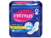
Overnight pads grew behind upc growth and launch of extra Proteção
The biggest losses came from decreased media investments and slight price increases in MT & TT.
OVERNIGHT PADS Volume Due-To (MM)
Nielsen MT & TT including C&C (~72% of shipments)
%
Change
5.3%
+4.0%
+2.7%
+0.9%
+0.2%
+0.1%
-0.1%
-0.3%
-1.1%
-1.1%
Launch of Extra Proteção and +12% UPCs in MT
Regular price changes primarily from Sempre Livre and Always
Always Overnight reduced volume sold on TPR by 35%
36 Units TPR activity fell 43% in Hyper markets
3% increase in price across ON Pads in MT and TT
Pay TV execution down 73%, and Open TV investment fell, too.

Slide 91
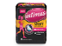
Switch from evolution to sport helped turn around premium pad sales
The biggest losses came from launch of Always Super Proteção and decreased media investments.
PREMIUM PADS Volume Due-To (MM)
Nielsen MT & TT including C&C (~72% of shipments)
%
Change
17.8%
+27%
+6.4%
+0.4%
-0.1%
-0.3%
-0.7%
-1.4%
-6.4%
-6.8%
Sport helped reverse course from Evolution’s decline in sales from 2016 to 2017.
Price cuts on 32 units and 8 units helped drive sales in MT
Premium Pads TPR activity increased behind move to Sport
Pay TV execution down 73%, and Open TV investment fell, too.
Increase in Sempre Livre’s price making it compete more vs. Premium.
Always Super Proteção stealing Premium’s sales and Mainline’s

Slide 92
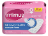
Liners pricing and loss of media drove decline in ytd 2018
Other key losses came from growth in UPCs from Always Liners and lower regular price within Carefree.
TOTAL LINERS Volume Due-To (MM)
Nielsen MT & TT including C&C (~72% of shipments)
%
Change
6.1%
+0.6%
-0.0%
-0.1%
-0.1%
-0.2%
-0.3%
-1.0%
-1.0%
-3.9%
Delisting of Respirave led to losses, while gained on 40 unit distribution in MT
Carefree Liners pricing within MT fell in most PPGs
Reduced TPR volume in MT and Gift activity in Farma
Always Liners grew significantly behind 2x in UPCs and 65% growth in UPCs
Pay TV execution down 73%, and Open TV investment fell, too.
Cost per pad increased 4% on 15 count, and 3% on 80 count

Slide 93
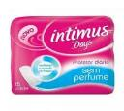
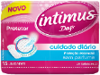

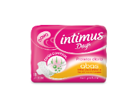
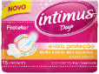
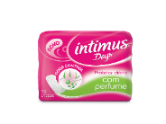
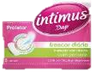
INTIMUS PACKING SHIFT CAUSED AN IMPACT IN SALES FOR THE BRAND
RESPIRAVEL WAS REMOVED AND IT REPRESENTED 17% OF THE PORTFOLIO
2016
17/Abr
17/Abr
Source: Nielsen l Retail Index – T. Brasil - INA + INFC l Intimus`s site https://www.intimus.com.br/produtos

Slide 94
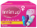
distribution gains in c&c 8 cT along with inclusion of sport tampons led the way
Biggest losses came from regular price increases and reduction in media execution.
TOTAL TAMPONS Volume Due-To (MM)
Nielsen MT & TT including C&C (~72% of shipments)
%
Change
7.0%
+5.8%
+5.6%
+1.0%
+0.8%
-0.0%
-0.3%
-0.7%
-1.1%
-4.0%
Growth in 8 count ACV (+25% in C&C, +4% in MT) and inclusion of Sport into product lineup.
OB raised price per pad by 6% in MT channel.
Increased seasonal impact during Carnaval period
Less effective TPR activity across both 16 count and 8 count
2x TPR increase of Tampax TPR activity, and 2x Sempre Livre OTV GRPs
Pay TV execution down 73%, and Open TV investment fell, too.
Increased price on 16 count by 10% in MT.

Slide 95
Intimus segments share
Source: Nielsen l Retail Index – T. Brasil - INA + INFC

Slide 96
Low national media contribution (5% Norm) driven by limited and declining TV presence
OTV is a key volume driver…where and when we are on air. These regions, however, make up 25% of total Intimus sales country-wide in 2017 and 13% in YTD18!
% Volume Contribution
for Nielsen MT & TT
A&CP Incremental Sales
The volume that sold solely due to the presence of media and consumer promotion
1,515 MSU
1,478 MSU
Price Discounting Incremental Sales
The volume that sold solely due to the presence of in-store price discounting activity
Base Sales
The volume that would have moved in absence of any marketing/trade activity. Common drivers are distribution, everyday price, competitive activity, seasonality, category trend, etc.
Total Intimus
Notes:
Typically, the volume driven by media activities will represent between 0 and 10% of total volume over a two year period. This depends entirely on how much advertising (GRPs) is delivered to the market. An individual campaign, in its most effective week, might deliver around 20% of total volume for that week.
Incremental sales
The volume that sold solely due to the presence of the marketing/discounting activity
Base sales
The volume that would have moved in absence of any marketing/trade activity. Common drivers are distribution, everyday price, competitive activity, seasonality, category trend, etc.

Slide 97
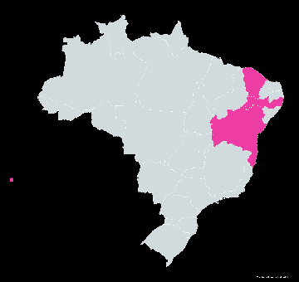
Open tv is a key volume driver…where we are on air
Overall media contribution across total Brazil was 1.8% during FY 17.
…But we must take into consideration that:
In the regions where we executed Open TV, media contributions were 3.4%.
These regions, however, make up 25% of total Intimus sales country-wide!
Recife
Salvador
Fortaleza
São Paulo Metro
Mainline Pads | Overnight Pads | Premium Pads | Liners | Tampons
3.8% | 3.6% | 2.2% | 2.5% | 4.3%
*Volume contributions represent across markets of Recife, Salvador, Fortaleza, São Paulo Metro – Modern Trade and Traditional Trade

Slide 98


Low national media contribution (5% Norm) driven by limited and declining TV presence
OTV is a key volume driver…where and when we are on air. These regions, however, make up 25% of total Intimus sales country-wide in 2017 and 13% in YTD18!
% Volume Contribution
for Nielsen MT & TT
2,521MSU
2,640MSU
1,478 MSU
A&CP Incremental Sales
The volume that sold solely due to the presence of media and consumer promotion
Price Discounting Incremental Sales
The volume that sold solely due to the presence of in-store price discounting activity
Base Sales
The volume that would have moved in absence of any marketing/trade activity. Common drivers are distribution, everyday price, competitive activity, seasonality, category trend, etc.
Total Intimus
Notes:
Typically, the volume driven by media activities will represent between 0 and 10% of total volume over a two year period. This depends entirely on how much advertising (GRPs) is delivered to the market. An individual campaign, in its most effective week, might deliver around 20% of total volume for that week.
Incremental sales
The volume that sold solely due to the presence of the marketing/discounting activity
Base sales
The volume that would have moved in absence of any marketing/trade activity. Common drivers are distribution, everyday price, competitive activity, seasonality, category trend, etc.

Slide 99
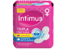
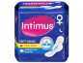
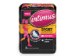
Volume Contribution by segment
% Volume Contribution
for Nielsen MT & TT by Segment
A&CP Incremental Sales
The volume that sold solely due to the presence of media and consumer promotion
742 MSU
710 MSU
248 MSU
261 MSU
13 MSU
15 MSU
Price Discounting Incremental Sales
The volume that sold solely due to the presence of in-store price discounting activity
Base Sales
The volume that would have moved in absence of any marketing/trade activity. Common drivers are distribution, everyday price, competitive activity, seasonality, category trend, etc.
Mainline Pads
Overnight Pads
Premium Pads
Notes:
Typically, the volume driven by media activities will represent between 0 and 10% of total volume over a two year period. This depends entirely on how much advertising (GRPs) is delivered to the market. An individual campaign, in its most effective week, might deliver around 20% of total volume for that week.
Incremental sales
The volume that sold solely due to the presence of the marketing/discounting activity
Base sales
The volume that would have moved in absence of any marketing/trade activity. Common drivers are distribution, everyday price, competitive activity, seasonality, category trend, etc.

Slide 100
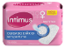
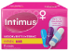
Volume Contribution by segment
% Volume Contribution
for Nielsen MT & TT by Segment
426 MSU
400 MSU
86 MSU
92 MSU
A&CP Incremental Sales
The volume that sold solely due to the presence of media and consumer promotion
Price Discounting Incremental Sales
The volume that sold solely due to the presence of in-store price discounting activity
Base Sales
The volume that would have moved in absence of any marketing/trade activity. Common drivers are distribution, everyday price, competitive activity, seasonality, category trend, etc.
Liners
Tampons
Notes:
Typically, the volume driven by media activities will represent between 0 and 10% of total volume over a two year period. This depends entirely on how much advertising (GRPs) is delivered to the market. An individual campaign, in its most effective week, might deliver around 20% of total volume for that week.
Incremental sales
The volume that sold solely due to the presence of the marketing/discounting activity
Base sales
The volume that would have moved in absence of any marketing/trade activity. Common drivers are distribution, everyday price, competitive activity, seasonality, category trend, etc.

Slide 101
CPIs with both a Masterbrand and product hEro generate the highest variant lifts
Linking Sport to a Manifesto should improve its halo onto other variants
 | Mainline | Overnight | Premium | Liners | Tampons
 | 3.0% | 3.5% | 2.6% | 2.0% | 2.7%
 | 6.3% | 4.7% | 3.2% | 4.5% | 3.1%
 | 5,7% | 4.8% | 3.9% | 4.2% | 4.2%
 | 3.6% | 2.8% | 5.0% | 3.1% | 2.3%
 | 5.4% | 5.8% | 4.5% | 4.3% | 2.8%
Intimus Commercial Program
Carnaval-SJ R$0.7
Normalized OTV & PTV Lift per 100 HH GRPs
Marias R$3.4 2016-17
Hero
Manifesto
LMO R$10.7 2017-18
Halo
Arrow size a function of response
Sport R$2.8 2018
Brazil K-C Fem Care 2018 Marketing Mix Modeling
She Can R$0.9 2018

